Slide 1
Selection of important features and predicting wine quality using machine learning techniques

Slide 2
Problem statement
Preservatives in wines - necessary ingredient but how much is too much?
Does it influence other attributes of wine?
Alcohol content
Understand dependencies between different wine attributes
Can we answer these questions by using the data about already made wines?

Slide 3
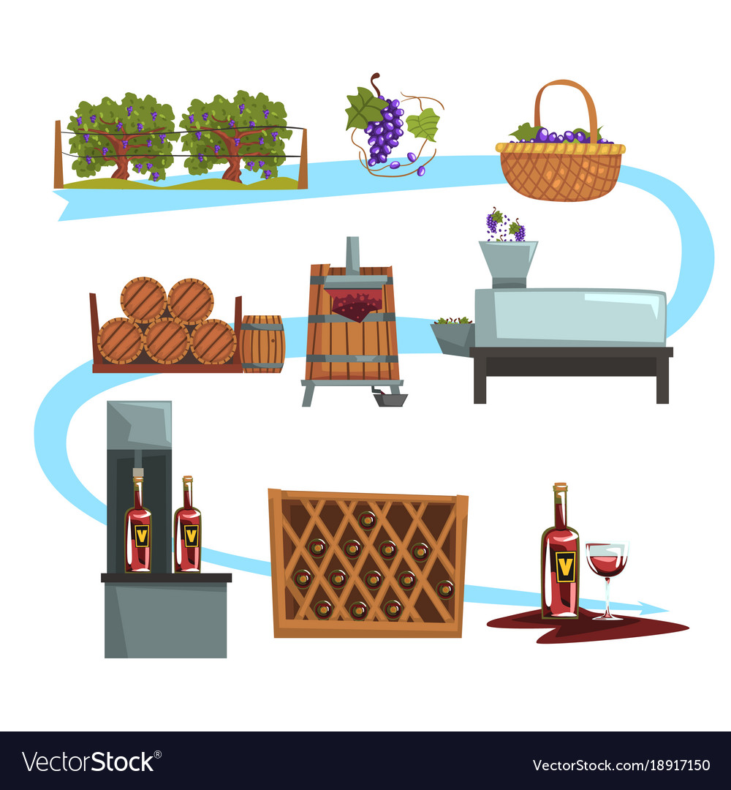
Production process impact the attributes of wines

Slide 4
Data
fixed acidity measure of tartaric acid [g/dm3]
volatile acidity amount of acetic acid [g/dm3]
citric acid - amount of citric acid [g/dm3]
residual sugar - amount of residual sugar [g/dm3]
Chlorides amount of sodium chloride [g/dm3]
free sulfur dioxide measure of sulfur dioxide [mg/dm3]
total sulfur dioxide measure of sulfur dioxide [mg/dm3]
Density amount of undissolved sugar [g/cm3]
pH potential of hydrogen of wine [mole]
sulphates amount of potassium sulphate [g/dm3]
Alcohol [vol.%]
Quality number from range 0 -10

Slide 5
Models
Classification techniques – clustering – unsupervised learning
Machine Learning technique:
Naïve Bayes
Decision Tree
Random Forest
Gradient Boosted Trees
Generalized Linear Model
Support Vector Machine

Slide 6
Conclusions
Gradient Boosted Technique – the highest accuracy to predict:
level of alcohol without given alcohol
balanced wine without given preservative – total sulfur dioxide
Generalized Linear model – the highest accuracy to predict sugar/ph level, without Ph level
Random Forest to predict quality rank

Slide 7
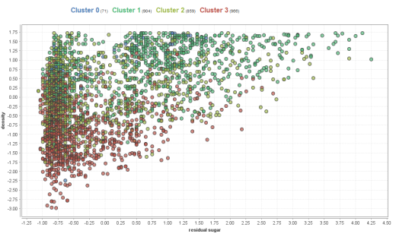
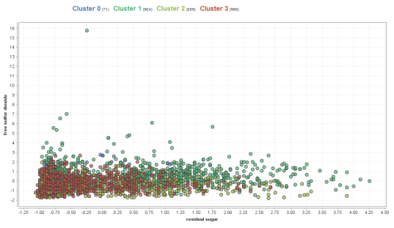
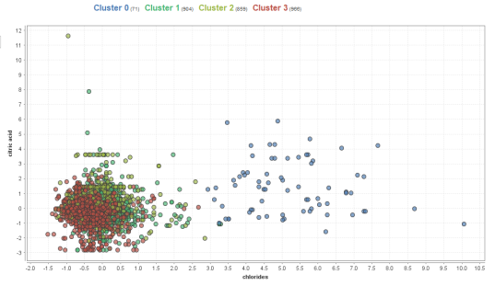
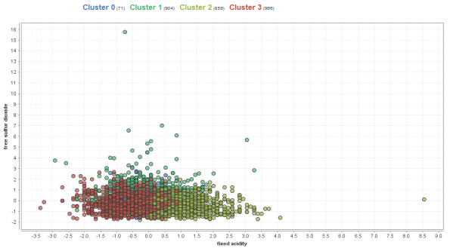
Conclusions - Patterns
4 clusters among more than 4000 wines.
Correlation between :
Ph ratio and chlorides
Ph ratio and Fixed acid
Residual sugar and density
Ph ratio and residual sugar
It is hard to predict Quality rank

